Slide 1

Chapter 21
Managing Credit Risk on the Balance Sheet
© McGraw Hill LLC. All rights reserved. No reproduction or distribution without the prior written consent of McGraw Hill LLC.

Slide 2
Credit Risk Management 1
Financial institutions (F I’s) are special because of their ability to efficiently transform financial claims of household savers into claims issued to corporations, individuals, and governments.
F I’s ability to process and evaluate information and control and monitor borrowers allows them to transform these claims at the lowest possible cost to all parties.
Credit allocation is a specific type of financial claim transformation.
F I’s transform claims of household savers (in the form of deposits) into loans issued to corporations, individuals, and governments.
The F I accepts the credit risk on these loans in exchange for a fair return sufficient to cover the cost of funding paid to household savers, the credit risk involved in lending, and a profit margin reflecting competitive conditions.

Slide 3
Credit Risk Management 2
Credit risk management is important for F I managers because it involves the determination of several features of a loan or debt instrument, such as the following:
Interest rate, maturity, collateral, and other covenants.
A single major economic event can cause losses to many F I’s loan portfolios.
Hurricanes Katrina and Rita in 2005 resulted in over $1.3 billion in bad loans for major banks operating in areas hit by the storm.
Financial crisis of 2008 to 2009 resulted in the largest ever credit risk-related losses for U S financial institutions.
On an international scale, bank loan portfolios were exposed to losses from the European debt crisis.

Slide 4
Credit Quality Problems 1
Credit quality of many F I’s lending and investment decisions has attracted a great deal of attention over the past three decades.
19 80’s - Issues with bank and thrift residential and farm mortgage loans.
Late 19 80’s and early 19 90’s – Attention shifted to the problems relating to commercial real estate loans and junk bonds.
Late 19 90’s – Concern shifted to the rapid increase in auto loans and credit cards as well as the declining quality in commercial lending standards as high-yield business loan delinquencies started to rise.
Late 19 90’s and early 2000’s – Attention has focused on problems with telecommunication companies, new technology companies, and a variety of sovereign countries.
2008 to 2009 – Foreclosures hit a record 1.5 million in the first half of 2009, and consumer bankruptcy filings rose to 1.06 million in 2008.
2010 to 2019 – U S economy slowly recovered, and nonperforming loan rates edged downward to some of the lowest levels seen throughout the 30-year period.

Slide 5
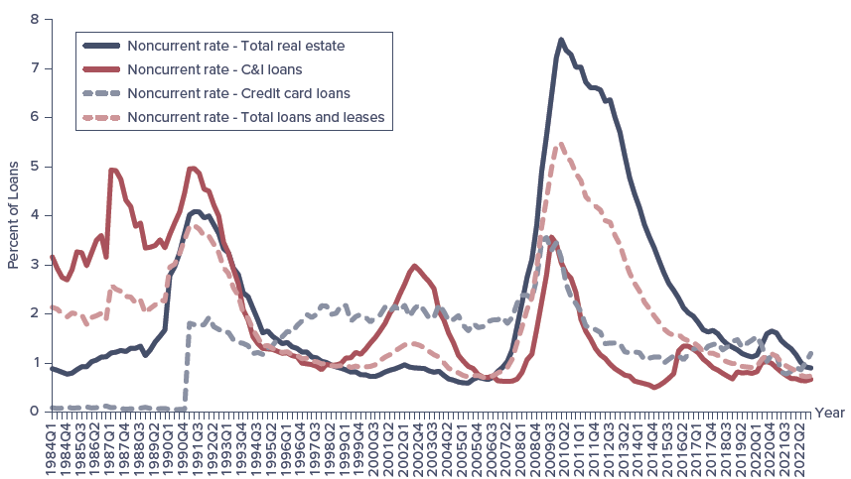
Nonperforming Asset Ratio for U S Commercial Banks
Note: Noncurrent loan rates represent the percentage of loans that are past due 90 days or more or in nonaccrual status.
Sources: Federal Deposit Insurance Corporation, Quarterly Banking Profile, various issues, www.fdic.gov
Access the text alternative for slide images.
Notes:
For FDIC-insured commercial banks, the ratio of nonperforming loans to assets declined significantly from 1992 through 2022 (see Figure 21–1).

Slide 6
Credit Quality Problems 2
Managerial efficiency and credit risk management strategies directly affect the return and risks of the loan portfolio.
One advantages that F I’s have over individual investors is the ability to diversify some credit risk by exploiting the law of large numbers in their asset investment portfolios.
A credit quality problem, in the worst case, can cause an F I to become insolvent, or it can result in such a significant drain on earnings and net worth that it can adversely affect the F I’s profitability and its ability to compete.

Slide 7
Credit Analysis: Real Estate Lending 1
Residential mortgage loan applications are among the most standardized of all credit applications.
Two considerations dominate an F I’s decision to approve a mortgage loan application:
Applicant’s ability and willingness to make timely interest and principal repayments.
    Established by application of qualitative and quantitative models.
    Character of applicant is extremely important, and is often assessed using factors such as stability of residence, occupation, family status, previous history of savings, and credit history.
Value of borrower’s collateral.
Loan officer must establish whether applicant has sufficient income.

Slide 8
Credit Analysis: Real Estate Lending 2
G D S and T D S are two ratios useful in determining a customer’s ability to maintain mortgage payments.
G D S refers to the gross debt service ratio.
  Equal to the total accommodation expenses (mortgage, lease, condominium, management fees, real estate taxes, etcetra) divided by gross income.
  Acceptable threshold generally set around maximum of 25% to 30%.
T D S refers to the total debt service ratio.
  Equal to the total accommodation expenses plus all other debt service payments divided by gross income.
  Acceptable threshold generally set around maximum of 35% to 40%.

Slide 9
Calculation of G D S and T D S Ratios 1
Example: Calculation of the G D S and T D S Ratios.
Consider two customers who have applied for a mortgage from an F I with a G D S threshold of 25 percent and a T D S threshold of 40 percent.
Customer | Gross Annual Income | Monthly Mortgage Payments | Annual Property Taxes | Monthly Other Debt Payments
1 | $150,000 | $3,000 | $3,500 | $2,000
2 | 60,000 | 500 | 1,500 | 200
The G D S and I D S ratios for the mortgage applicants are as follows:

Slide 10
Calculation of G D S and T D S Ratios 2
Despite a higher level of gross income, Customer I does not meet the G D S or T D S thresholds because of relatively high mortgage, tax, and other debt payments. Customer 2, while earning less, has fewer required payments and meets both the F I’s G D S and T D S thresholds.

Slide 11
Credit Scoring Systems
F I’s use credit scoring systems to calculate probability of default or to sort borrowers into different default risk classes.
Credit scoring systems are mathematical models that use observed characteristics of the loan applicant to calculate a score that represents the applicant’s probability of default.
Primary benefit is to improve the accuracy of predicting borrowers’ performance without using additional resources, resulting in fewer defaults and charge-offs to the F I.
Loan officers can often give immediate “yes”, “maybe”, or “no” answers —along with justifications for the decision.
Lender may use standard F I C O credit scores.
F I C O scale runs from 300 to 850.
F I’s also verify borrower’s financial statements.

Slide 12
Credit Analysis: Real Estate Lending 3
Perfecting collateral is the process of ensuring that collateral used to secure a loan is free and clear to the lender should the borrower default on the loan.
F I’s do not desire to become involved in loans that are likely to go into default.
In the event of default, lenders usually have recourse.
Foreclosure is the process of taking possession of the mortgaged property in satisfaction of a defaulting borrower’s indebtedness and forgoing claim to any deficiency.
Power of sale is the process of taking the proceedings of the forced sale of a mortgaged property in satisfaction of the indebtedness and returning to the mortgagor the excess over the indebtedness or claiming any shortfall as an unsecured creditor.

Slide 13
Prior to Accepting a Mortgage
Before an F I accepts a mortgage, it must satisfy itself regarding the property involved in the loan by doing the following:
Confirming the title and legal description of the property.
Obtaining a surveyor’s certificate confirming that the house is within the property’s boundaries.
Checking with the tax office to confirm that no property taxes are unpaid.
Requesting a land title search to determine that there are no other claims against the property.
Obtaining an independent appraisal to confirm that the purchase price is in line with the market value.

Slide 14
Consumer (Individual) and Small-Business Lending
Techniques are very similar to that of mortgage lending.
  Individual consumer loans are scored like mortgages.
Unlike mortgage loans, nonmortgage consumer loans focus on the individual’s ability to repay rather than on the property.
Credit-scoring models put more emphasis on personal characteristics (for example, annual gross income, T D S score, etcetra.).
Small-business scoring models often combine computer-based financial analysis of borrower financial statements with behavioral analysis of the business owner.
Usually, these loans are made to small businesses to help start up the company, and there is less history on which to base the loan.

Slide 15
Mid-Market Commercial and Industrial Lending
Generally, a profitable market for credit-granting F I’s.
Mid-market corporates are typically characterized as follows:
Sales revenues from $5 million to $100 million per year.
Recognizable corporate structure.
No ready access to deep and liquid capital markets.
Commercial loans can be made for periods as short as a few weeks to as long as 8 years or more.
Short-term commercial loans (those with an original maturity of one year or less) are used to finance working capital needs and other short-term funding needs.
Long-term loans are used to finance credit needs that extend beyond one year (for example purchase of real assets, new venture start-up costs, and permanent increases in working capital).
Notes:
Credit analysis of a mid-market corporate customer differs from that of a small business because, while still assessing the character of the firm’s management, its main focus is on the business itself.

Slide 16
Five C’s of Credit
To analyze the loan applicant’s credit risk, the account officer must understand the customer’s five C’s of credit:
Character refers to the probability that the loan applicant will try to honor the loan obligation.
Capacity is a subjective judgment regarding the applicant’s ability to pay the F I according to the loan terms.
Collateral is represented by assets that the loan applicant offers as security backing the loan.
Conditions refer to any general economic trends or special developments in certain geographic regions or economic sectors that may affect applicant’s ability to meet loan obligations.
Capital is measured by the general financial condition of the applicant as indicated by an analysis of the applicant’s financial statements and leverage.

Slide 17
Cash Flow Analysis
As an initial step of the loan analysis, F I’s require business loan applicants to provide cash flow (C F) information.
Statement of cash flows separates C F’s into four categories or sections:
C F from operating activities are those cash inflows and outflows that result directly from producing and selling the firm’s products.
C F from investing activities are C F’s associated with buying or selling fixed or other long-term assets.
C F from financing activities are C F’s that result from debt and equity financing transactions.
Net change in cash and marketable securities shows sum of C F’s from operations, investing activities, and financing activities.
C F’s from operating activities section are most critical to the F I in evaluating the loan applicant.
Notes:
When evaluating the cash flow statement, FIs want to see that the loan applicant can pay back the loan with cash flows produced from the applicant’s operations. FIs do not (except as a last resort) want the loan applicant to pay back the loan by selling fixed assets or issuing additional debt.

Slide 18
Statement of Cash Flows 1
A. Cash flows from operating activities.
Net income.
Additions (sources of cash):
Depreciation.
Decrease noncash current assets.
Increase accrued wages and taxes.
Increase accounts payable.
Subtractions (uses of cash):
Increase noncash current assets.
Decrease accrued wages and taxes.
Decrease accounts payable.
B. Cash flows from investing activities.
Additions:
Decrease fixed assets.
Decrease other long-term assets.
Subtractions:
Increase fixed assets.
Increase other long-term assets.
Notes:
The basic setup of a statement of cash flows is presented in Table 21–2.

Slide 19
Statement of Cash Flows 2
C. Cash flows from financing activities.
Additions:
Increase notes payable.
Increase long-term debt.
Increase common and preferred stock.
Subtraction:
Decrease notes payable.
Decrease long-term debt.
Decrease common and preferred stock.
Pay dividends.
D. Net change in cash and marketable securities.

Slide 20
Ratio Analysis 1
Calculation of financial ratios is useful when performing financial statement analysis on a mid-market applicant.
Time series analysis examines the applicant’s business over time, while cross-sectional analysis compares the applicant’s ratios to those of its competitors.
Liquidity ratios express the variability of liquid resources relative to potential claims.
Asset management ratios give clues as to how well the applicant uses its assets relative to its past performance and the performance of the industry.
Debt and solvency ratios give an idea of the extent to which the applicant finances its assets with debt versus equity.
Profitability ratios express the profitability of the firm.
Notes:
Key to cross-sectional analysis is identifying similar firms that compete in the same markets, have similar size assets, and operate in a similar manner to the firm being analyzed. Since no two firms are identical, obtaining such a comparison group is no easy task.

Slide 21
Ratio Analysis 2
Ratio analysis has limitations:
Many firms operate in more than one industry, and it can be difficult to construct a meaningful set of industry averages for these firms.
Different accounting practices can distort industry comparisons.
Can be difficult to generalize whether a particular value for a ratio is good or bad.
Common-size analysis and growth rates:
Common-size financial statements are constructed by dividing all income statement amounts by total sales revenue and all balance sheet amounts by total assets.
Year-to-year growth rates give useful ratios for identifying trends.
Before drawdown, conditions precedent must be cleared.
Notes:
Conditions precedent are those conditions specified in the credit agreement that must be fulfilled before drawdowns are permitted. These include various title searches, perfecting of collateral, and the like.

Slide 22
Large Commercial and Industrial Lending
F I’s bargaining strength is severely diminished when it deals with large creditworthy corporate customers.
Large corporations are characterized by the following:
Able to issue debt and equity directly in the capital markets, as well as to make private placements of securities.
Typically maintain credit relationships with several F I’s and have significant in-house financial expertise.
Manage their cash position through the money markets by issuing their own commercial paper to meet fund shortfalls and use excess funds to buy T-bills, banker’s acceptances, and other companies’ C P.
Not seriously restricted by international boarders.
Very attractive to F I’s.
F I’s relationship goes beyond lending and may include role of broker, dealer, and/or advisor.
Credit management remains an important issue.

Slide 23
Altman’s Z-Score
E.I. Altman developed a Z-score model for analyzing publicly traded manufacturing firms in the U S.
Z is an overall measure of the borrower’s default risk classification.
where

Slide 24
Altman’s Z-Score Interpretation
Default classifications (according to Altman):
Z < 1.81 – high default risk firm.
1.81 < Z < 2.99 – indeterminate default risk firm.
Z > 2.99 – low default risk firm.
Problems associated with Z-score model:
Usually discriminates only among three cases of borrower behavior – high, indeterminate, and low default risk.
No obvious economic reason to expect the weights in the Z-score model (or, the weights in any credit-scoring model) will be constant over any but very short periods.
Ignores hard-to-quantify factors that may play a crucial role in the default or no-default decision.
Accounting variables are updated infrequently.

Slide 25
Calculation of Altman’s Z-Score 1
Example: Calculation of Altman's Z Score.
Suppose that the financial ratios of a potential borrowing firm take the following values:
The ratio
is zero and
is negative, indicating that the firm has had
negative earnings or losses in recent periods. Also,
indicates that the
borrower is highly leveraged. However, the working capital ratio
and the sales/assets ratio
indicate that the firm is reasonably.

Slide 26
Calculation of Altman’s Z-Score 2
liquid and is maintaining its sales volume. The Z score provides an overall score or indicator of the borrower’s credit risk since it combines and weights these five factors according to their past importance in explaining (discriminating between) borrower default and borrower repayment. For the borrower in question:
With a Z score less than 1.81 (that is, in the high default risk region), the F I should not make a loan to this borrower until it improves its earnings.

Slide 27
Moody’s Analytics Credit Monitor Model
In recent years, we now recognize that when a firm raises funds either by issuing bonds or by increasing its bank loans, it holds a very valuable default or repayment option.
If a borrower’s investments fail, so that it cannot repay its bond holders or the loan to the F I, it has the option to default on its debt and turn any remaining assets over to the debtholder.
If things go well, the borrower can keep most of the upside returns on asset investments after the promised principal and interest on the debt have been paid.
K M V Corporation has turned this relatively simple idea into a credit-monitoring model, used by many of the largest U S banks to determine expected default frequency (E D F), the probability that the market value of the firm’s assets will fall below the promised repayments on debt liability in one year.
Simulations have shown this model outperforms others as predictors of corporate failure and distress.
Notes:
If the value of a firm’s assets falls below its debt liabilities, it can be viewed as being economically insolvent.

Slide 28
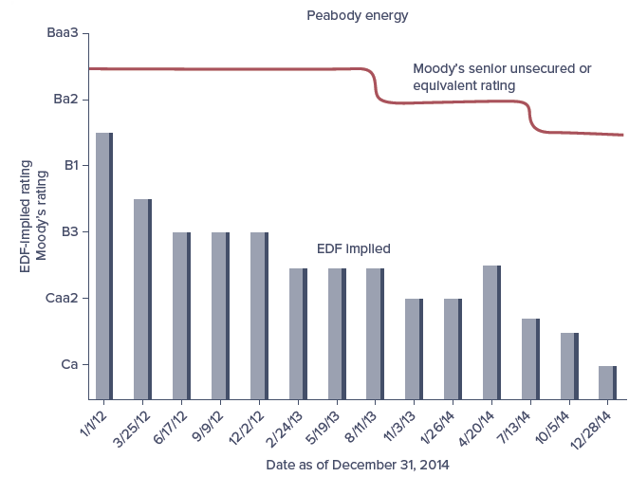
Moody’s Analytics E D F and Moody’s for Peabody Energy Corporation
Access the text alternative for slide images.
Notes:
An example for Peabody Energy Corp., which filed for Chapter 11 bankruptcy protection in April 2016, is shown in Figure 21–2. Note that the Moody’s Analytics score (EDF) is rising earlier than rating agencies are downgrading the firm’s debt. Indeed, the rating agencies were very slow to react to, if not totally insensitive to, the increase in Peabody Energy risk. The Moody's Analytics EDF score starts to fall three years prior to Peabody Energy's bankruptcy and suggests a C rating by November 2013. Thus, the Moody’s Analytics EDF score gives a better “early warning” of impending default.

Slide 29
Calculating the Return on a Loan: Return on Assets (R O A) 1
Factors that impact the promised return that an F I achieves on any given dollar loan (asset) amount include:
Interest rate on the loan.
Any fees relating to the loan.
Credit risk premium (m) on the loan.
Collateral backing the loan.
Other nonprice terms (for example, compensating balances, reserve requirements).
Direct and indirect fees and charges relating to a loan fall into three categories:
Loan origination fee (f) charged to borrower for application processing.
Compensating balance requirement (b) to be held as generally non-interest-bearing demand deposits.
Reserve requirement charge (R R) imposed by the Fed on the bank’s demand deposits, including any compensating balances.
Notes:
An important element in the credit management process, once the decision to make a loan has been made, is its pricing. This includes adjustments for the perceived credit risk or default risk of the borrower.
This section demonstrates two ways to calculate the return on a loan: the traditional return on assets approach and a newer approach used by many FIs including banks, thrifts, and insurance companies called risk-adjusted return on capital (RAROC), which considers loan returns in the context of the risk of the loan to the FI.

Slide 30
Calculating the Return on a Loan: Return on Assets (R O A) 2
Return on assets (R O A) approach shows the contractually promised gross return on a loan, k, per dollar lent (or 1 + k) – or R O A per dollar lent – will equal:
Numerator of formula is promised gross cash inflow to the F I per dollar lend, reflecting direct fees (f) plus the loan interest rate (B R + m).
Net outflow by the F I per $1 of loans is 1 − b (1 − R R), or 1 minus the reserve-adjusted compensating balance requirement.

Slide 31
Calculation of R O A on a Loan 1
Example: Calculation of R O A on a Loan.
Suppose a bank does the following:
Sets the loan rate on a prospective loan at 10 percent (where B R= 6% and m = 4%).
Charges a
percent (or 0.125 percent) loan origination fee (f) to
the borrower.
Imposes a 8 percent compensating balance requirement (b) to be held as noninterest-bearing demand deposits.
Sets aside reserves (R R) at a rate of 10 percent of deposits, held at the Federal Reserve (that is, the Fed's cash-to-deposit reserve ratio is 10 percent).

Slide 32
Calculation of R O A on a Loan 2
Placing the numbers from our example into this formula, we have:
This is, of course. larger than the simple promised interest return on the loan, B R + m = 10 percent.

Slide 33
Calculating the Return on a Loan: R A R O C Models
Essential idea behind R A R O C is that rather than evaluating the actual or promised annual cash flow on a loan as a percentage of the amount lent (or R O A), the lending officer balances the loan’s expected income against the loan’s expected risk.
Loan is approved by F I only if R A R O C is sufficiently high relative to a benchmark return on equity capital.
Loan should be made only if the risk-adjusted return on the loan adds to the F I’s equity value, as measured by the R O E required by the F I’s stockholders.
R A R O C serves as a credit-risk measure and a loan pricing tool.
Notes:
The numerator of the RAROC equation is net income (or ROA – Cost of funding the loan) on the loan.
The denominator in the RAROC equation is an estimate of the unexpected overall loss on the loan in extreme conditions such as the worst year in the next 100 years, which is the product of the unexpected default rate and the loss given default.

Slide 34
Calculation of R A R O C 1
Example: Calculation of R A R O C.
Suppose a borrower of $100,000 has risk characteristics that put the firm in a risk class that has experienced an average historical default rate of 0.2 percent. However, one year in every 100 (or 1 percent of the time), such as in a major recession, the bank expects 4 percent of these types of loans to default. This 4 percent can be viewed as the unexpected or 1 in 100 years default rate. Moreover, upon default, the F I has historically recovered only 20 percent of the defaulted loans. As a result, the loss given default is 80 percent. Accordingly, for this borrower, the loan loss risk per dollar.
lent is
or the value (or capital) at risk
to the F I (the denominator of the R A R O C equation) is

Slide 35
Calculation of R A R O C 2
Suppose the cost of funds for the F I is 9.80 percent and the loan rate is 10 percent on the $100,000 loan. After adjusting for fees of 0.1 percent, the expected one-year income on the loan, or the numerator of the R A R O C equation, is $100,000 times 0.3 cents per dollar lent
or 0.003. The extreme case loss rate for borrowers of this type is 4 percent (that is, the default that has or is projected to occur once in every 100 years), and the dollar proportion of loans of this type that cannot be recaptured on default (loss given default) has historically been 80 percent. Then:
If the F I’s R O E is less than 9.375 percent (for example, it is 9 percent), the loan can be viewed as being profitable. If the R O E is higher than 9.375 percent (for example, 9.5 percent), it should be rejected and/or the loan officer should seek higher spreads and fees on the loan.

